Slide 1
Decision Making
Topic 3

Slide 2
Areas discussed include….
Describing the eight steps in the decision-making process.
Explaining the four ways managers make decisions.
Classifying decisions and decision-making conditions.
Describing different decision-making styles and discuss how biases affect decision making.
Identifying effective decision-making techniques.

Slide 3
Video Clip
Decision Making (Lecture format) (9.07 mins) (Management Decision Making Styles #10)
Henry Mintzberg on Decision Making (4.04 mins)

Slide 4
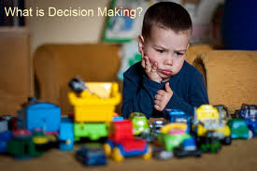

Slide 5

The Decision Making Process
Decision - making a choice from two or more alternatives.
Managers at all levels and in all areas of organisations make decisions,
they make choices.
Decision making is typically described as choosing among alternatives, but ….. this view is too simplistic!
Why?
Because decision making is (and should be) a process,
not just a simple act of choosing among alternatives.

Slide 6
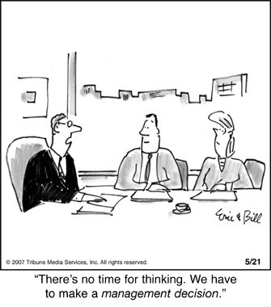

Slide 7
Quotes on Decision Making
“Good decisions come from experiences. Experiences come from bad decisions.”
(Mark Twain, American author, B. 1835 – D. 1910).
“Whenever you see a successful business, someone once made a courageous decision.”
Peter Drucker, American author & business consultant (B1909 – D. 2005)
“It does not take much strength to do things, but it requires a great deal of strength to decide what to do.”
(Elbert Hubbard, American writer & philosopher, B 1856 – D. 1915)

Slide 8
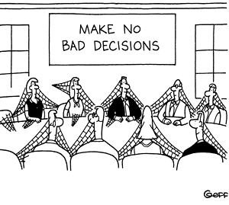

Slide 9
The Decision Making Process
The decision-making process is a set of eight steps ….
…. that include identifying a problem, selecting an alternative, and evaluating the decision’s effectiveness.
(See next slide for an illustration of the decision-making process.)

Slide 10
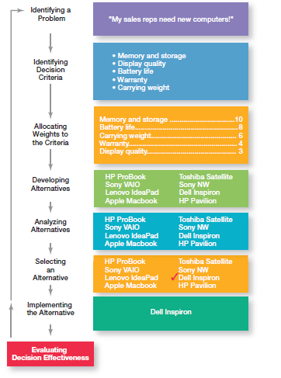
Decision Making Process (Source: Robbins & Coulter, 2014)

Slide 11
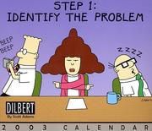

Slide 12

The Decision-Making Process: Step 1
Step 1: Identify a Problem
Every decision starts with a problem,
A Problem is an obstacle that makes it difficult to achieve a desired goal or purpose.
In order to identify a problem, you (as a manager) should recognise and understand the three characteristics of problems:
1. You must be aware of the problem.
Be sure to identify the actual problem, rather than a symptom of the problem.
2. You must be under pressure to act.
A true problem puts pressure on the manager to take action; a problem without pressure to act is a problem that can be postponed.
3. You must have the authority or resources to act.
When managers recognise a problem and are under pressure to take action but do not have necessary resources, they usually feel that unrealistic demands are being put upon them.

Slide 13
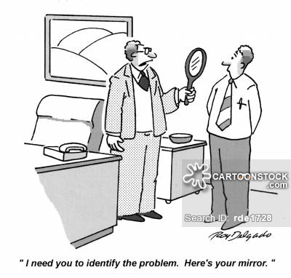
“I need you to identify the problem. Here’s your mirror”

Slide 14

The Decision-Making Process: Step 1
Example - Amanda is a sales manager whose reps need new laptops because their old ones are outdated and inadequate for doing their job.
To make it simple, assume it is not economical to add memory to the old computers and it is the company’s policy to purchase, not lease.
Now we have a problem - a disparity between the sales reps current computers (existing condition) and their need to have more efficient ones (desired condition).
Amanda has a decision to make!

Slide 15

The Decision-Making Process: Step 2
Step 2: Identify Decision Criteria
Decision criteria are factors that are important (relevant) to a decision or to resolving the problem
Every decision maker has criteria guiding his or her decisions even if they are not explicitly stated
Example - Amanda decides that memory and storage capabilities, display quality, battery life, warranty, and carrying weight are the relevant criteria in her decision.

Slide 16

The Decision-Making Process: Step 3
Step 3: Allocate Weights to the Criteria
If the relevant criteria are not equally important, the decision maker must assign a ‘weight’ to the items,
in order to give them the correct priority in the decision.
How?
A simple way is to give the most important criterion a weight of 10 and then assign weights to the rest using that standard.
Can use any number as the highest weight.
Next slide lists the criteria and weights for Amanda’s purchase decision for new computers.

Slide 17

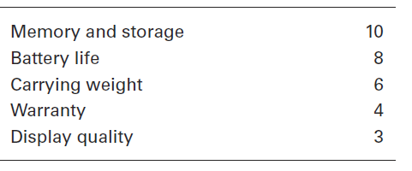
Important Decision Criteria (for Amanda’s decision)

Slide 18
The Decision-Making Process: Step 4
Step 4: Develop Alternatives
List viable alternatives that could resolve the problem.
In this step, a decision maker needs to be creative, and the alternatives are only listed - not evaluated - just yet.
Example - Amanda, identifies eight laptops as possible choices.
(See next slide)

Slide 19
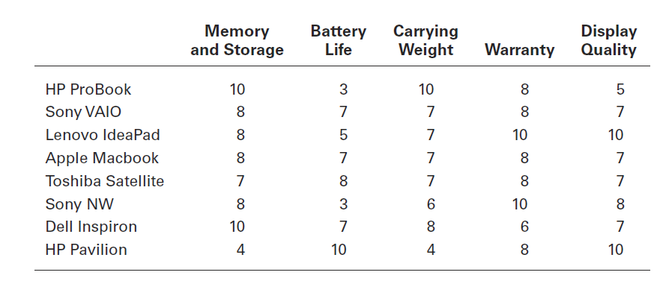
Possible Alternatives (for Amanda’s decision)

Slide 20

The Decision-Making Process: Step 5
Step 5: Analyse Alternatives
Each of the alternatives must now be critically analysed by evaluating it against the criteria established in steps 2 and 3
Appraising each alternative’s strengths and weaknesses,
An alternative’s appraisal is based on its ability to resolve the issues related to the criteria and criteria weight.
For Amanda;
Previous slide shows the values that Amanda assigned to each of her alternatives for a new computer.
Slide ‘Evaluation of Alternatives’ (2 further slides on!) reflects the weighting for each alternative.

Slide 21
The Decision-Making Process: Step 5
Step 5: Analyse Alternatives (cont)
Previous slide (‘Possible Alternatives’) shows the assessed values that Amanda gave each alternative after doing some research on them.
Note – this data represent an assessment of the eight alternatives using the decision criteria, but not the weighting.
When you multiply each alternative by the assigned weight, you get the weighted alternatives as shown in next slide.
The total score for each alternative, then, is the sum of its weighted criteria.
Sometimes a decision maker might be able to skip this step.
If one alternative scores highest on every criterion, you wouldn’t need to consider the weights because that alternative would already be the top choice.
Or if the weights were all equal, you could evaluate an alternative merely by summing up the assessed values for each one. (See slide 19, the score for the HP ProBook would be 38, and the score for the Sony NW would be 35.)

Slide 22
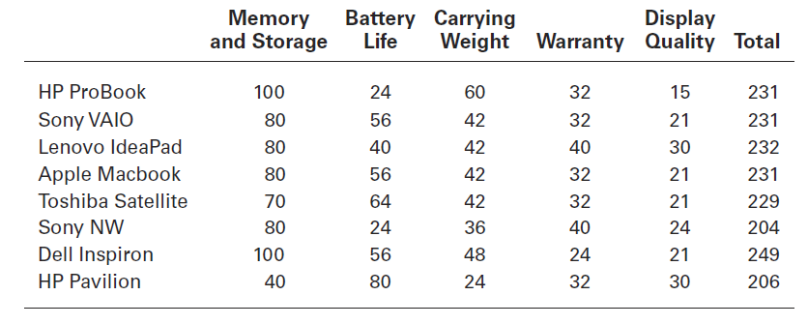
Evaluation of Alternatives

Slide 23

The Decision-Making Process: Step 6
Step 6: Select an Alternative
Choosing the best alternative from those identified and assessed,
the best alternative or the one that received the highest score in Step 5.
Example: Amanda would choose the Dell Inspiron because it scored higher than all other alternatives (249 total).

Slide 24
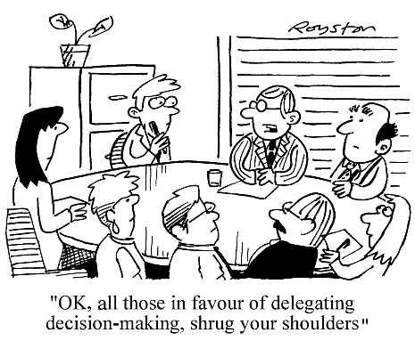
“OK, all those in favour of delegating decision making, shrug your shoulders”

Slide 25

The Decision-Making Process: Step 7
Step 7: Implement the Alternative
The selected alternative must be implemented by,
1. Effectively communicating the decision to the individuals who will be affected by it,
2. and winning their commitment to the decision,
If the people who must implement a decision participate in the process, they are more likely to support it.
3. Managers may need to reassess the environment for any changes, especially if it is a long-term decision.
Are the criteria, alternatives, and choice still the best ones, or has the environment changed in such a way that we need to reevaluate?

Slide 26

The Decision-Making Process: Step 8
Step 8: Evaluate Decision Effectiveness
Assess the result of the decision to determine whether or not the problem has been resolved.
The soundness of the decision is judged by its outcomes.
If the problem was not resolved, …. then the manager needs to assess ‘what went wrong’?
Was the problem incorrectly defined?
Were errors made when evaluating alternatives?
Was the right alternative selected but poorly implemented?
The answers might lead the manager to redo an earlier step or might even require starting the whole process over.

Slide 27
Decision Making Process (Source: Robbins & Coulter, 2014)

Slide 28

Managers Making Decisions
Although everyone in an organisation makes decisions, decision making is particularly important to managers.
That is why it is said - that decision making is the ‘essence of management’.
And that is why managers - when they plan, organise, lead, and control - are called Decision Makers.
This next section will explore the manager as a decision maker and how decisions are actually made in organisations.
Including ; how decisions are made, the types of problems and decisions faced by real-life managers, the conditions under which managers make decisions, and decision-making styles.

Slide 29
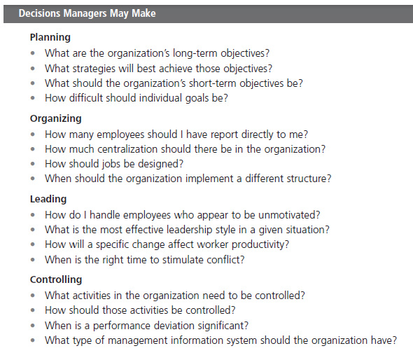

How Decision Making Fits into the Four Functions of Management (Source: Robbins & Coulter, 2014)

Slide 30
How Decision Making Fits into the Four Functions of Management (Source: Robbins & Coulter, 2014)

Slide 31
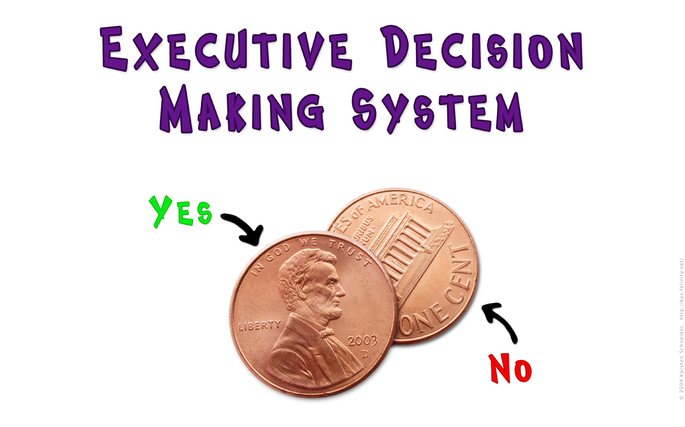

Slide 32
Making Decisions: Rationality
Managerial decision making is assumed to be rational - that is, making choices that are consistent and value-maximizing within specified constraints.
If a manager could be perfectly rational, he or she would be completely logical and objective.
Rational Decision-Making - describes choices that are logical and consistent while maximising value.
We assume that managers will use rational decision making
After all, managers have all sorts of tools and techniques to help them be rational decision makers
But ….. Managers are not always rational!

Slide 33




Slide 34
Making Decisions: Rationality
Assumptions of Rationality
1. Rational decision making assumes that the manager is making decisions in the best interests of the organization, not in his or her own interests.
2. The assumptions of rationality can be met if the manager is faced with a simple problem in which;
(1) goals are clear and alternatives limited,
(2) time pressures are minimal and the cost of finding and evaluating alternatives is low,
(3) the organisational culture supports innovation and risk taking, and
(4) outcomes are concrete and measurable.
Making decisions rationally would consistently lead to selecting the alternative that maximises the likelihood of achieving that goal.

Slide 35
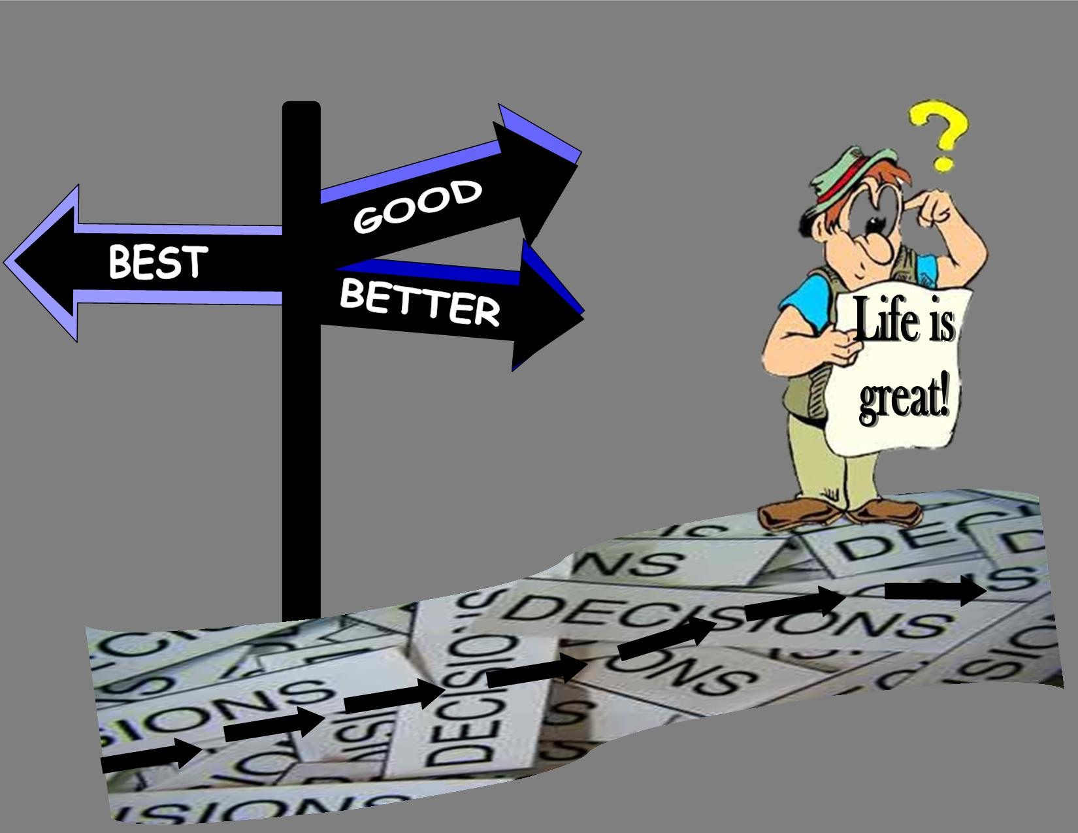

Slide 36
Making Decisions: Bounded Rationality
Because the perfectly rational model of decision making is not realistic, managers tend to operate under assumptions of bounded rationality,
…. which says that managers make decisions rationally, but are limited (bounded) by their ability to process information.
This is a more realistic approach to describing how managers make decisions.
Some flaws still evident …. ‘Satisfying’ & ‘Escalation of Commitment’
1. Under bounded rationality, because managers can not possibly analyse all information, on all alternatives, managers satisfice, rather than maximise,
Managers make satisficing decisions, in which they accept solutions that are “good enough.”

Slide 37
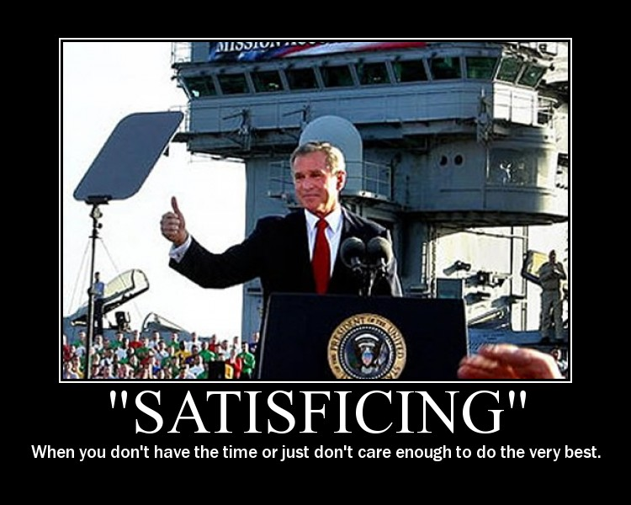

Slide 38
Making Decisions: Bounded Rationality
A manager’s decision making is also likely influenced by the organisation’s culture, internal politics, power considerations, and….
……. by a phenomenon called escalation of commitment,
Escalation of commitment - An increased commitment to a previous decision despite evidence that it may have been wrong!

Slide 39
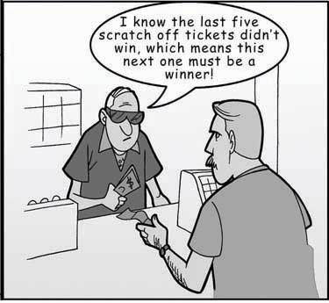
Escalation of Commitment!

Slide 40
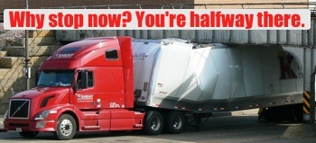
Escalation of Commitment!

Slide 41

Making Decisions: The Role of Intuition
Intuitive decision- making
A subconscious process of making decisions on the basis of experience, feelings, and accumulated judgment.
Managers regularly use their intuition.
Making decisions on the basis of gut feeling does not necessarily happen independently of rational analysis; the two complement each other.
Although intuitive decision making will not replace the rational decision-making process, it does play an important role in managerial decision making.
Researchers studying managers’ use of intuitive decision making have identified five different aspects of intuition, which are described in the next slide.

Slide 42
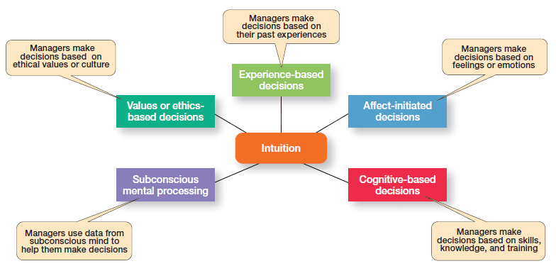
5 Different Aspects of Intuition (Source: Robbins & Coulter, 2014)

Slide 43
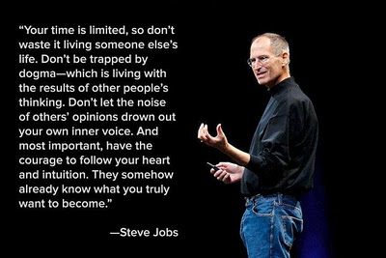
Intuition ….

Slide 44

Making Decisions: The Role of Evidence-Based Management
The principle behind evidence-based management (EBMgt) is that any decision making process is likely to be enhanced through the use of relevant and reliable evidence.
whether it is buying someone a birthday present or wondering which new washing machine to buy.
EBMgt promotes the ‘systematic’ use of the best available evidence to improve management practice.

Slide 45
Making Decisions: The Role of Evidence-Based Management
The four essential elements of EBMgt are;
the decision maker’s expertise and judgment,
external evidence that has been evaluated by the decision maker,
opinions, preferences, and values of those who have a stake in the decision,
and relevant organisational (internal) factors such as context, circumstances, and organisational members.
The strength or influence of each of these elements on a decision will vary with each decision.
The key for managers is to recognise and understand the mindful, conscious choice as to which element(s) are most important and should be emphasised in making a decision.

Slide 46


TYPES OF DECISIONS AND DECISION-MAKING CONDITIONS
Managers encounter different types of problems and use different types of decisions to resolve them.

Slide 47
Types of Decisions: Structured Problems
Some problems are straightforward.
Structured problems are straightforward, familiar, and easily defined.
The decision maker’s goal is clear, the problem is familiar, and information about the problem is easily defined and complete.
Because it is not an unusual occurrence, there is probably some standardised routine for handling it.
A manager may use a programmed decision, which is a repetitive decision that can be handled by a routine approach.

Slide 48

Structured Problems and Programmed Decisions
Programmed decision – a repetitive decision that can be handled by a routine approach
Because the problem is structured, the manager does not have to go to the trouble and expense of going through an involved decision process.
The “develop-the-alternatives” stage of the decision-making process either doesn’t exist or is given little attention.
Why?
Because once the structured problem is defined, the solution is usually self-evident or at least reduced to a few alternatives that are familiar and have proved successful in the past.

Slide 49
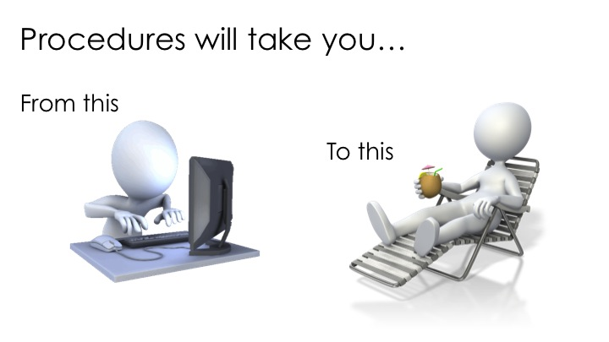
Structured Problems and Programmed Decisions
Managers rely on three types of programmed decisions
Procedures, Rules and Policies
1. Procedure - a series of sequential steps a manager uses to respond to a structured problem.
The only difficulty is identifying the problem.
Once it is clear, so is the procedure.
E.G.; a purchasing manager receives a request from a warehouse manager for 15 computer tablets for the inventory clerks.

Slide 50

Structured Problems and Programmed Decisions
2. Rule - an explicit statement that tells managers what can or can not be done.
Rules are frequently used because they are simple to follow and ensure consistency.
E.G: rules about lateness and absenteeism permit supervisors to make disciplinary decisions rapidly and fairly.

Slide 51

Structured Problems and Programmed Decisions
3. Third type of programmed decisions is a policy, a guideline for making a decision.
In contrast to a rule, a policy establishes general parameters for the decision maker rather than specifically stating what should or should not be done.
Policies typically contain an ambiguous term that leaves interpretation up to the decision maker.
Lower-level managers mostly rely on programmed decisions (procedures, rules, and policies) because they confront familiar and repetitive problems.

Slide 52
Unstructured Problems and Non-Programmed Decisions
Unstructured Problems - problems that are new or unusual and for which information is ambiguous or incomplete.
Not all the problems managers face can be solved using programmed decisions.
Many organisational situations involve unstructured problems
Non -programmed decisions - a unique and non-recurring decision which requires custom made solutions
Whether to build a new manufacturing facility in China is an example of an unstructured problem.
As managers move up the organisational hierarchy, the problems they confront become more unstructured.

Slide 53
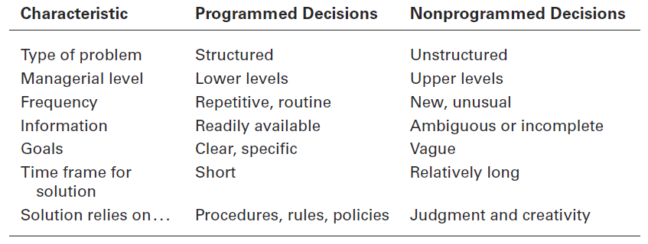
Differences Between Programmed Versus Non- programmed Decisions (Source: Robbins & Coulter, 2014)

Slide 54
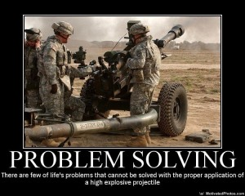

Slide 55
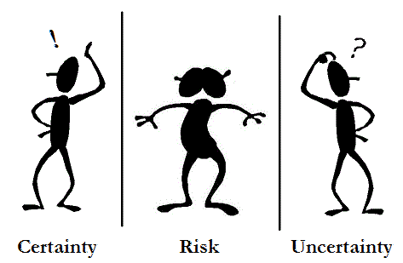
Decision-Making Conditions

Slide 56

Decision-Making Conditions: Certainty
Certainty - a situation in which a manager can make accurate decisions because the outcome of every alternative is known.
The ideal situation for making decisions is one of certainty,
Few managerial decisions are made under the conditions of certainty
E.g. When the Irish Finance minister decides where to deposit excess state funds (if they exist!), he/she knows exactly the interest rate offered by each bank and the amount that will be earned on the funds.
The Minister is certain about the outcomes of each alternative.
most managerial decisions are not like this!

Slide 57

Decision-Making Conditions: Risk & Uncertainty
Risk - a situation in which the decision maker is able to estimate the likelihood of certain outcomes
Far more common situation than certainty.
Under risk, managers have historical data from past personal experiences or secondary information that lets them assign probabilities to different alternatives.
Uncertainty - a situation in which a decision maker does not have certainty and can not even make reasonable probability estimates concerning the alternative outcomes.
Under these conditions, the choice of alternative is influenced by the limited amount of available information and by the psychological orientation of the decision maker.

Slide 58

Decision-Making Conditions: Risk & Uncertainty
Uncertainty
The decision is influenced by the psychological orientation of the decision maker.
1) An optimistic manager will follow a maximax choice, maximizing the maximum possible payoff.
2) A pessimistic manager will pursue a maximin choice, maximising the minimum possible payoff.
3) The manager who desires to minimise the maximum “regret” will opt for a minimax choice.

Slide 59


Slide 60
Decision-Making Styles
Managers have different styles in making decisions and solving problems.
Research shows that people differ along two dimensions in the way they approach decision making.
(1) the source of information a person tends to use (external data and facts OR internal sources such as feelings and intuition),
(2) whether a person process that information in a linear way (rational, logical, analytical) OR a nonlinear way (intuitive, creative, insightful).

Slide 61

Decision-Making Styles
1. Linear Thinking Style
a person’s tendency to use external data/facts;
the habit of processing information through rational, logical thinking to guide decisions and actions.
2. Nonlinear Thinking Style
a person’s preference for internal sources of information (feelings and intuition);
a method of processing this information with internal insights, feelings, and hunches to guide decisions & actions.

Slide 62
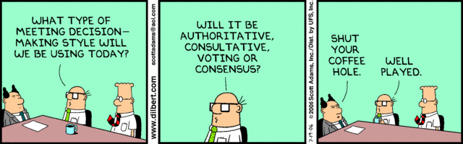
Decision-Making Styles

Slide 63
Decision-Making Biases and Errors
Managers use different styles and “rules of thumb” (Heuristics) to simplify their decision making.
Rules of thumb can be useful because they help make sense of complex, uncertain, and ambiguous information.
Even though managers may use rules of thumb, that does not mean those rules are reliable.
Why?
Because they may lead to errors and biases in processing and evaluating information!

Slide 64
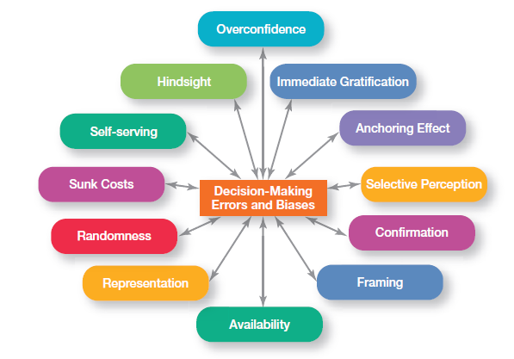
Common Decision-Making Biases (Source: Robbins & Coulter, 2014)

Slide 65

Decision-Making Biases and Errors
Overconfidence Bias;
When decision makers tend to think they know more than they do,
or hold unrealistically positive views of themselves and their performance, they’re exhibiting the overconfidence bias.

Slide 66
Overconfidence Bias
"People generally ascribe more credibility to data than is warranted and hence overestimate the probability of success merely due to the presence of an abundance of data" (Sage, 1981).
Consequences of Overconfidence Bias ….
Overconfident managers stop gathering and processing information about an issue sooner.
Selectively seeking out information that supports a position, while disregarding contradictory information.
Reduces analysis of data.
Discourages the examination of alternative ideas and solutions.
Confidence in decisions continues to climb as more and more information is obtained.
This bias is most extreme in tasks of great difficulty

Slide 67
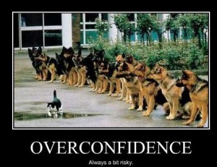
Over confidence – always a bit risky!

Slide 68


Decision-Making Biases and Errors
Immediate Gratification Bias; describes decision makers who tend to want immediate rewards and to avoid immediate costs.
For these individuals, decision choices that provide quick payoffs are more appealing than those with payoffs in the future.

Slide 69
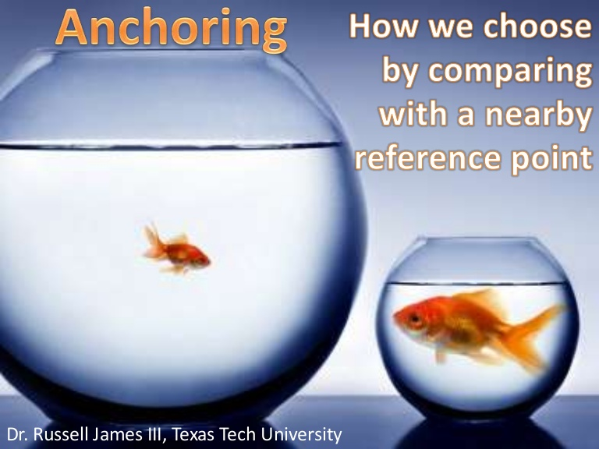
Decision-Making Biases and Errors
Anchoring Effect; decision makers fixate on initial information as a starting point and then, once set, fail to adequately adjust for subsequent information.
First impressions, ideas, prices, and estimates carry unwarranted weight relative to information received later.

Slide 70
Anchoring Effect
Once the “anchor” or initial information is set, there exists a bias for interpreting other information around the anchor.
When you buy a car, salespeople deliberately throw out an anchor number, because they know the general population will insufficiently adjust from there, making the subsequent negotiated prices seem lower than the initial price even though they are still higher than what the vehicle is actually worth.
Avoid this bias by verifying facts you are given. And if going into a negotiation, it is to your advantage to be the first one to throw out the anchor.

Slide 71

Decision-Making Biases and Errors
Selective Perception Bias; When decision makers selectively organise and interpret events based on their biased perceptions, they are using the selective perception bias.
This influences the information they pay attention to the problems they identify, and the alternatives they develop.

Slide 72
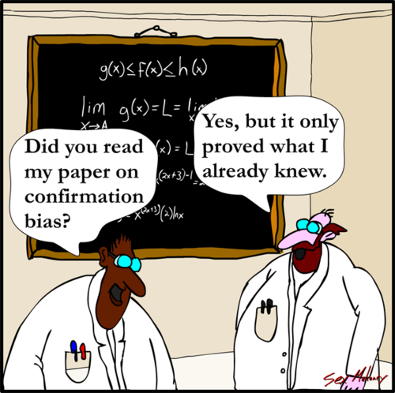
Decision-Making Biases and Errors
Confirmation Bias; Decision makers who seek out information that reaffirms their past choices and discount information that contradicts past judgments exhibit the confirmation bias.

Slide 73
Confirmation Bias
People who only seek evidence that supports their beliefs or expectations will make decisions that are affected by confirmation bias.
This bias is often used when a person is in a debate and needs facts to support their desired outcome. The problem comes when disconfirming evidence surprises and weakens their position.
Avoid confirmation bias by applying professional skepticism to decisions.
Consider the opposite or explain why your initial assessment could be incorrect.
This exercise forces you to take the time and mental effort to thoughtfully consider the limitations of your chosen solution.

Slide 74
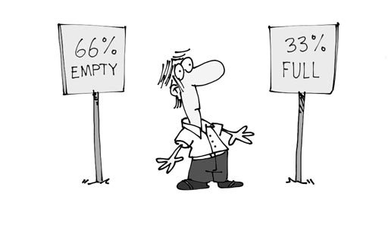

Decision-Making Biases and Errors
Framing Bias - when decision makers select and highlight certain aspects of a situation while ignoring other aspects.
By drawing attention to specific aspects of a situation and highlighting them, while at the same time downplaying or omitting other aspects, they distort what they see and create incorrect reference points.

Slide 75
Decision-Making Biases and Errors
Availability Bias – can be seen when decision makers tend to remember events that are most recent and vivid in their memory.
Usually the first piece of information that we have on that subject.
The result? It distorts their ability to recall events in an objective manner and results in distorted judgments and probability estimates.
Availability bias is especially misleading when information is subjective.
If you are asked to evaluate your own performance relative to the performance of others, for example, most people will rate their own contribution to be higher, because that is the information they have most available.
Avoid this bias by routinely asking for feedback from others before making a decision.

Slide 76
Example of Availability Bias
A successful executive who attended Yale is likely to remember fellow alums he encounters in his business circle and his social life.
But his success places him in a narrow professional and social stratum.
Because of his special, restricted range of experiences he is likely to overestimate the relative proportion of successful Yale graduates (because he meets them all) and to underestimate the proportion of unsuccessful Yale graduates (because he never meets them).
Range of experience can trigger the availability bias

Slide 77
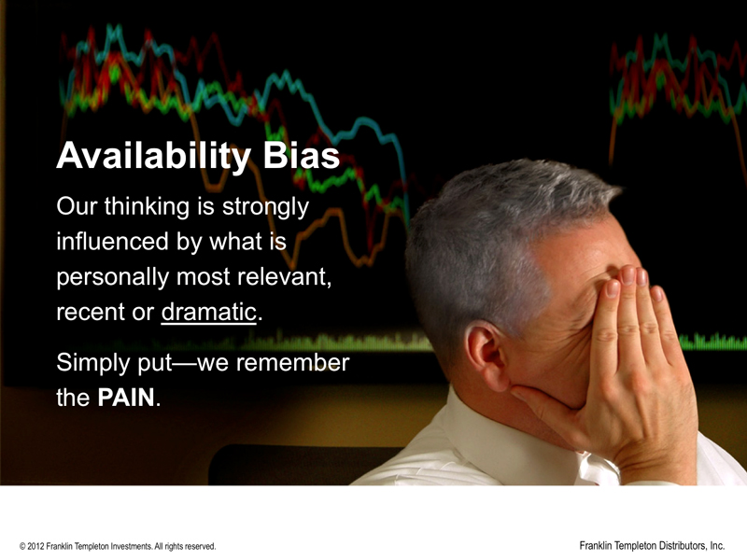

Slide 78
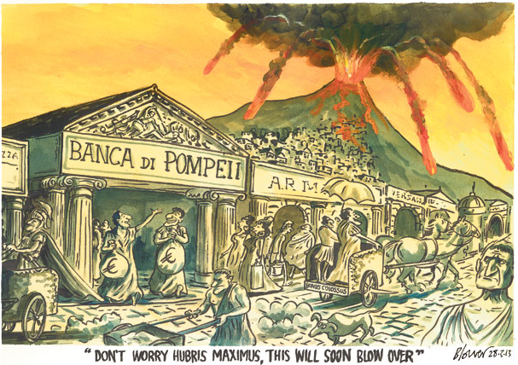
Decision-Making Biases and Errors
Representation Bias; When decision makers assess the likelihood of an event based on how closely it resembles other events or sets of events.
Managers exhibiting this bias draw analogies and see identical situations where they do not exist!

Slide 79
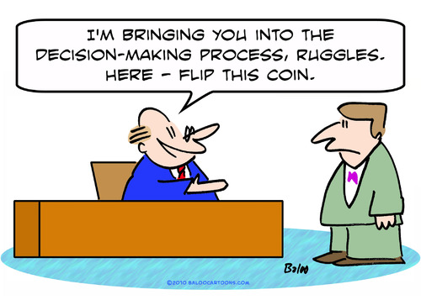
Decision-Making Biases and Errors
Randomness Bias; describes the actions of decision makers who try to create meaning out of random events.
They do this because most decision makers have difficulty dealing with chance,
even though random events happen to everyone, and there is nothing that can be done to predict them!

Slide 80
Decision-Making Biases and Errors
Sunk Costs Errors; decision makers forget that current choices can not correct the past.
Instead of ignoring sunk costs, they can not forget them,
They incorrectly fixate on past expenditures of time, money, or effort in assessing choices, rather than on future consequences.
If someone makes a decision about a current situation, based all or in part on what they have previously invested (money, time or otherwise) in the situation, they are suffering from sunk-cost error.
Not matter how much you are down on an investment, if it’s likely to never be recovered, then cut your losses and let it go.

Slide 81
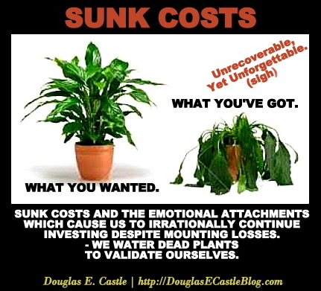

Slide 82
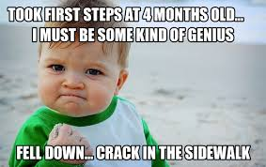
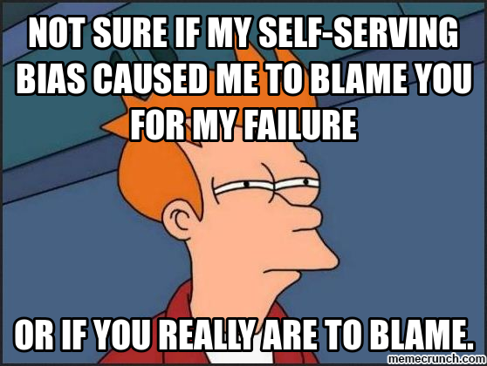
Decision-Making Biases and Errors
Self-Serving Bias; Decision makers who are quick to take credit for their successes and to blame failure on outside factors, are exhibiting the self-serving bias.

Slide 83
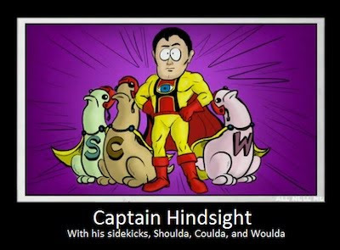
Decision-Making Biases and Errors
Hindsight Bias - the tendency for decision makers to falsely believe that they would have accurately predicted the outcome of an event once that outcome is actually known (after-the-fact).

Slide 84
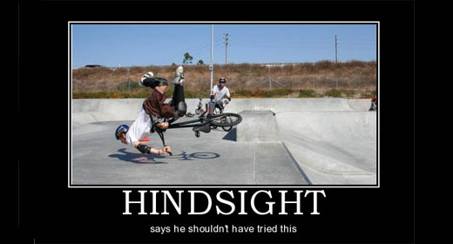

Slide 85
Common Decision-Making Biases (Source: Robbins & Coulter, 2014)

Slide 86
Some Interesting Data Regarding Decision Making (Source: Kahneman, Lovallo and Siboney, 2011)
7% higher returns is what organisations gained when they reduced the effect of bias in their decision-making processes.
90% of people believe they are just a little more competent, smarter, or kinder than average.
91% of U.S. companies use teams and groups to solve specific problems.
54% of managers said the amount of time given to each decision had decreased.
77% of managers said the number of decisions they made during a typical workday had increased.
59% of employees said a key obstacle to their job is that more attention is paid to placing blame than to solving problems.
20% of American adults said they think most creatively in their cars.

Slide 87
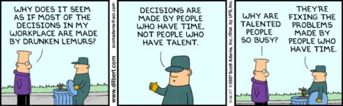
Decision Makers …..

Slide 88
Overview of Managerial Decision Making
Managers want to make good decisions because doing so is in their best interests.
…. that is,
choose the “best” alternative,.
… implement it, …
…. and determine whether it takes care of the problem.
…. Which is the reason the decision was needed in the first place!

Slide 89
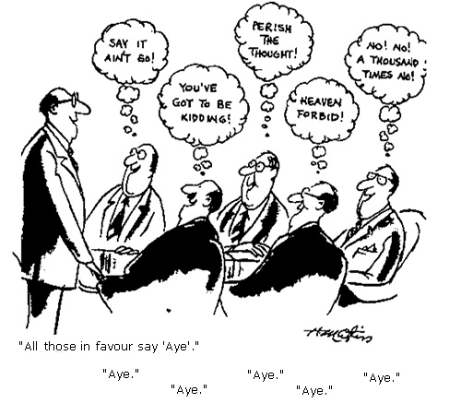
An example of managerial decision making!!

Slide 90
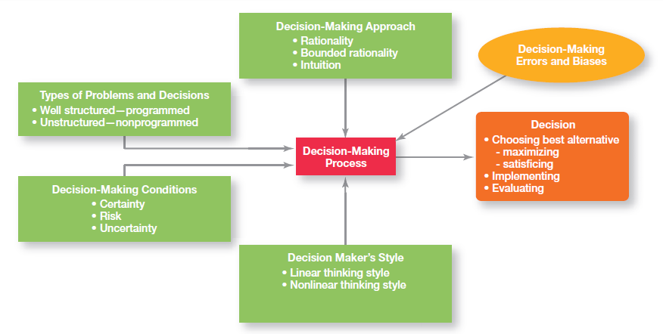
Overview of Managerial Decision Making (Source: Robbins & Coulter, 2014)

Slide 91

Effective Decision Making for Today’s World
Decision making is serious business.
Today’s business world revolves around making decisions, which are often risky ones made with incomplete or inadequate information and under intense time pressure.
A person’s abilities and track record as an effective decision maker will determine how their organisational work performance is evaluated and whether they will be promoted to higher positions of responsibility.
How can managers make effective decisions under these conditions?
Following slides provide some guidelines for Effective Decision Making

Slide 92
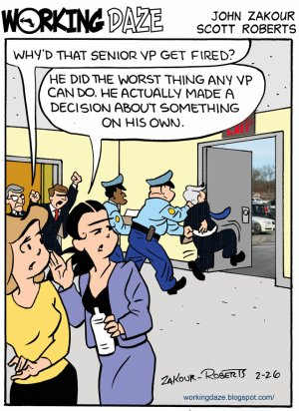

Slide 93
Guidelines for Making Effective Decisions
1. Understand cultural differences
Managers everywhere want to make good decisions.
However, is there only one “best” way worldwide to make decisions?
Or does the “best way depend on the values, beliefs, attitudes, and behavioral patterns of the people involved?”

Slide 94

Guidelines for Making Effective Decisions: Understanding Cultural Differences

Slide 95
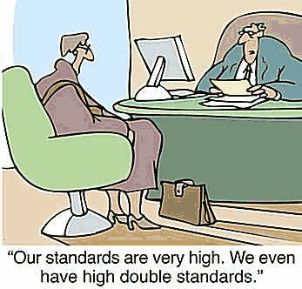
Guidelines for Making Effective Decisions
2. Create standards for good decision making
Good decisions are forward-looking,
use available information,
consider all available and viable options,
and do not create conflicts of interest.

Slide 96
Guidelines for Making Effective Decisions
3. Know when it’s time to call it quits
When it is evident that a decision is not working, do not be afraid to pull the plug.
4. Use an effective decision making process
5. Build an organisation that can spot the unexpected and quickly adapt to the changed environment.
Build highly reliable organisations (HROs) that practice five habits (see next slide)

Slide 97

Guidelines for Making Effective Decisions
Build highly reliable organisations (HROs) that practice the following five habits:
Do not be tricked by your own success.
Defer to the experts on the front lines.
Let unexpected circumstances provide the solution.
Embrace complexity.
Anticipate, but also recognise the limits to your ability to anticipate.

Slide 98

Design Thinking and Decision Making
Design thinking - is described as “approaching management problems, as designers approach design problems”.
(Dunne & Martin, 2006)
It can be useful when identifying problems and when identifying and evaluating alternatives.
The way managers approach decision making;
using a rational and analytical mindset in identifying problems,
coming up with alternatives,
evaluating alternatives,
and choosing one of those alternatives
May not be best and certainly not the only choice in today’s environment ….
…. That is where ‘Design Thinking’ comes in.

Slide 99
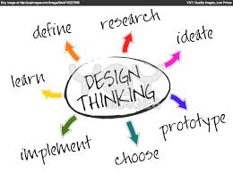

Slide 100

Design Thinking and Decision Making
More organisations are beginning to recognise how design thinking can benefit them.
Apple has long been celebrated for its design thinking.
The company's lead designer, Jonathan "Jony" Ive (who was behind some of Apples most successful products, including the iPod and iPhone and was just knighted in the United Kingdom for services to design and enterprise) said about Apple's design approach:
"We try to develop products that seem somehow inevitable - that leave you with the sense that, that is the only possible solution that makes sense.”
(Martin & Euchner, 2012)

Slide 101
Design Thinking and Decision Making
“A traditional manager (educated in a business school, of course) would take the options that have been presented, and analyse them based on deductive reasoning and then select the one with the highest net present value. However, using design thinking, a manager would say, "What is something completely new that would be lovely if it existed but doesn't now?”
(Dunne and Martin, 2006)
Design Thinking means opening up your perspective and gaining insights by using observation and inquiry skills and not relying simply on rational analysis.
This is not to say that rational analysis is not needed … what is suggested is that there is more needed in making effective decisions, especially in today's world.

Slide 102
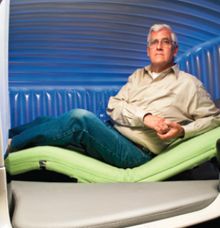
Design Thinking and Decision Making – Example – Boeing Concept Centre
The design thinking approach to decision making is at the heart of Boeing's Concept Centre, a developmental studio where engineers and designers create innovative concepts for airplane interiors through research, prototypes, mock- ups, and interactive workshops.
The goal of the centre is to help Boeing's airline provide their passengers and crew members with innovative products and services that enhance the flying experience.
In this photo, Alan Anderson, director of the centre, poses in a prototype of an inflatable crew rest module that features a sound system and adjustable recliner and that can be deflated to a fraction of its size for ease of installation and removal.
Design thinking has helped underscore Boeing's reputation as a customer-focused and innovative company.

Slide 103
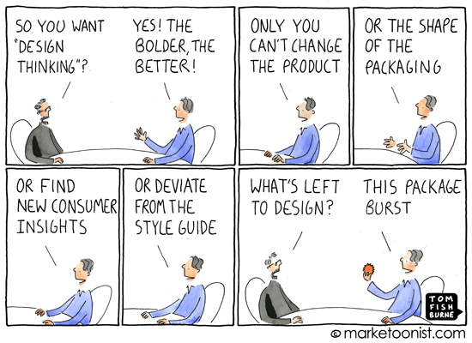
Design Thinking … not always easy!

Slide 104
Class Exercise
Being effective in decision making is something that managers obviously want.
What is involved with being a good decision maker?
Form groups of three to four students.
Discuss your experiences making decisions
(e.g. buying a car or some other purchase, choosing college, making summer or holiday plans)
Each of you should share times when you felt you made good decisions.
Analyse what happened during that decision-making process that contributed to it being a good decision.
Now … consider some decisions that you felt were bad.
What happened to make them bad?
What common characteristics, if any, did you identify among the good decisions? The bad decisions?
Come up with a bulleted list of practical suggestions for making good decisions.

Slide 105
Reference List
Dunne, D and Martin, R., (2006) "Design Thinking and How It Will Change Management Education: An Interview and Discussion," Academy of Management Learning & Education, December, p. 512.
Kahneman., D, Lovallo, D. and Siboney, O., (2011) “Before You Make That Big Decision. Harvard Business Review, June , pp. 50-60
Martin, R. and Euchner , J. (2012) "Design Thinking," Research Technology Management, May/June
Robbins, S. and Coulter, M. (2104), Management, Pearson

